Slide 1

CSE 207: Computational Complexity
Dr. Md. Shamsuzzoha Bayzid
Department of Computer Science and Engineering Bangladesh University of Engineering and Technology

Slide 2
Computational Complexity
In many search problems, we have to find the optimal solution from an exponentially large number of possible solutions
Shortest path problem
Minimum spanning tree
Surprisingly, we have polynomial time solutions to some of them
These are exceptions!
But there are many problems for which we don’t have any efficient algorithm
Efficient algorithms: O(n^{k}) time algorithm (that’s the norm)

Slide 3


Computational Complexity
There are many problems for which we don’t have any efficient algorithm
How do you know there is no efficient solution (like the lower bound on comparison based sorting)?
I cannot solve it efficiently because I am dumb!
I cannot find an efficient solution because there isn’t any!
Image credit: “Computers and Intractability” by Garey and Johnson

Slide 4
Computational Complexity
It is really hard to prove that there is no efficient algorithm for a particular problem.
How do you know there is no efficient solution (like the lower bound on comparison based sorting)?
What to do?
Show that the problem is as hard as many other problems that have been worked on by a host of brilliant scientists over a very long time, yet there is no efficient solutions
A fundamental aspect of complexity theory is categorizing problems into such equivalence classes
Comparing relative difficulty of different problems

Slide 5
Computational Complexity
Decision problems are suitable for this framework
A decision problem is a problem whose output is a single boolean value: YES or NO.
Given a CNF Boolean formula, is there any satisfying assignment?
(X v Y v Z) ^ (X’ v Y’ v Z)
Conversion:
Shortest path (Optimization problem): Find the shortest path between two nodes s and t in a graph G
Shortest path (Decision problem): Is there a path P between s and t in G such that p <= x?
Do you see why a bound (p <=x) is required here?

Slide 6
P and NP
P: Set of decision problems that can be solved in polynomial time
Relatively easier problems that can be solved quickly!
NP: Set of decision problems with a polynomial time verification for a “YES” answer
We can verify a “YES” answer if we have the solution in front of us.
Formally, given an input (instance) I and a solution S, we can efficiently check whether S indeed corresponds to the “YES” answer.
Hard to find, but easy to recognize!

Slide 7
P and NP
Example: Is the following Boolean formula satisfiable?
(X v Y v Z) ^ (X’ v Y’ v Z)
There is no efficient algorithm (to date) to solve this decision problem. May not be in P (but nobody knows)
What if we are given an assignment and just need to verify whether it satisfies the given Boolean formula?
I: (X v Y v Z) ^ (X’ v Y’ v Z); S: X = 1, Y = 0, Z = 1
We can check in polynomial time whether S satisfies I.
The satisfiability problem is in NP!
Do you see why there is no efficient algorithm to verify the “NO” answer?

Slide 8
Optimization vs. Decisions/search problem
Turning an optimization problem to a search problem does not necessarily change its difficulty.
They reduce to one another!
?
How?
Solving the optimization problem readily solves the decision
Find the shortest path and see if it is within the budget
You can also know the shortest path by using the solutions to the decision problem.
Do you see how?

Slide 9
P and NP
P is a subset of NP
Every decision problem in P is also in NP.
x є P => x є NP
There is a polynomial time algorithm A which solves problem x. Therefore, an efficient certifier B just ignore the certificate and solves the problem from scratch. That means B will run A and returns the output of A.

Slide 10
P and NP
Is NP a subset of P? P = NP?
Is there a problem in NP that does not belong to P? P ≠ NP?

Slide 11
What we think the world looks like
NP
P

Slide 12
Complement of a problem
For every problem X, there is a natural complementary problem X’
If the answer to X is “YES”, the answer to X’is “NO”
SAT: Is a given boolean formula in CNF satisfiable?
UNSAT: Is a given boolean formula in CNF unsatisfiable?

Slide 13
Complement of a problem
x є P => x’ є P
We have an efficient algorithm A to solve X.
We can design an algorithm A’ for X’ which runs A
and flip the answer

Slide 14
Complement of a problem
Is it true that x є NP => x’ є NP?
Just because you have an efficient certifier for X does not mean that you can design an efficient certifier for X’
YES answers verification involves “there exist” quantifier, whereas NO answer verification involves “for all”

Slide 15
co-NP
x є NP => x’ є co-NP?
co-NP: Set of decision problems with a polynomial time verification for a “NO” answer
Just the opposite to NP
UNSAT: Is a given Boolean formula unsatisfiable?
UNSAT є co-NP

Slide 16
co-NP
PRIME: Is a given number x prime?
NO answer verification is easy; PRIME is in co-NP
YES answer verification does not seem to be easy
PRIME is in P (Agarwal, Kayal, and Saxena (AKS))

Slide 17
NP and co-NP
Does NP = co-NP?
We don’t know yet!
What is the relationship between P and co-NP?
P is a subset of co-NP
x є P => x є co-NP
If the answer is NO for a problem and you can solve it in polynomial time, you can verify the NO answer without looking at the certificate

Slide 18
NP and co-NP
What is the relationship between P and co-NP?
P is a subset of co-NP
x є P => x’ є P => x’ є NP => x є co-NP
x є P => x є co-NP

Slide 19
What we think the world looks like
co-NP
NP
P

Slide 20
P, NP, co-NP
Just like P and NP, the widespread belief is that
NP ≠ co-NP
But we don’t know!
Proving NP ≠ co-NP is even a bigger step than proving P ≠ NP

Slide 21
P, NP, co-NP
Just like P and NP, the widespread belief is that
NP ≠ co-NP
But we don’t know!
Proving NP ≠ co-NP is even a bigger step than proving P ≠ NP
x є P => x’ є P => x’ є NP => x є co-NP

Slide 22
P, NP, co-NP
NP ≠ co-NP => P ≠ NP
P = NP => NP = co-NP
P is closed under complementation. So if P = NP, then
NP = P = çomplement of P = co-NP
NP is a subset of co-NP
x є NP => x є P => x’ є P => x’ є NP => x є co-NP
co-NP is a subset of NP
x є co-NP => x’ є NP => x’ є P => x є P => x є NP

Slide 23
Assignment
Assignment
“It is possible that P ≠ NP, yet NP = co-NP”
Do you agree with this statement? Justify your answer

Slide 24
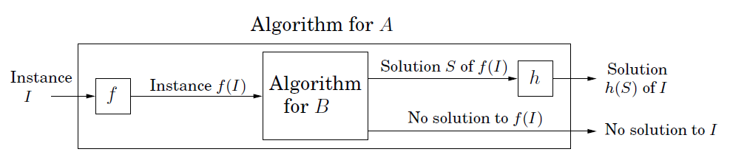
Polynomial-time Reductions
Reduction
A ≤p B
Problem A is polynomial time reducible to problem B
If A ≤p B and if we have a blackbox that solves B, then we can solve A by reducing and instance of A into an instance of B
Image credit: “Algorithms”, Das, Gupta, and Vazirani

Slide 25

Polynomial-time Reductions
Reduction
A ≤p B
Problem A is polynomial time reducible to problem B
A is at least as hard as B
B is at least as hard as A

Slide 26
Polynomial-time Reductions
Reduction
A ≤p B
Problem A is polynomial time reducible to problem B
If you can solve B in polynomial time,
then you can solve A in polynomial time
If you cannot solve A in polynomial time,
then you cannot solve B in polynomial time
Difficullty flows from A to B;
Efficiency flows from B to A

Slide 27
NP-hard problems
NP-hard
Problem X is an NP-hard problem if
for all Y є NP, Y ≤p X
A problem X is NP-hard if a polynomial-time algorithm for X would imply a polynomial-time algorithm
for every problem in NP.

Slide 28
NP-complete problems
NP-complete
Problem X is an NP-complete problem if:
i) X є NP
ii) for all Y є NP, Y ≤p X
NP-complete problems are the hardest problems in NP
NP-complete is a set of problems with the “same level of” difficulty
Notes:
Same level of difficulty because each problem in NPC can be reduced to others. So they define both upper bound and lower bound on the difficulty. However, NP-hard problems define a lower bound. Because it is possible that one NP-hard cannot be reduced to another NP-hard.

Slide 29
What we think the world looks like
NP-hard
NP-complete
co-NP
NP
P

Slide 30
Proof of NP-completeness
NP-complete
You have to prove that for all problems Y є NP, Y ≤p X
Alternative: Prove that a known NP-complete problem Y ≤p X

Slide 31
Vertex Cover
A vertex cover of a graph is a set S of nodes such that every
edge has at least one endpoint in S.
We try to “cover” each of the edges by choosing at
least one of its vertices.
Vertex Cover
Given a graph G and a number k, does G contain a vertex cover
of size at most k.

Slide 32
Independent Set
An independent set of a graph is a set I of nodes such that
they are pairwise non-adjacent.
Independent Set
Given graph G and a number k, does G contain a set of at least k
independent vertices?

Slide 33
Independent Set to Vertex Cover
Independent Set
Given graph G and a number k, does G contain a set of at least k
independent vertices?
Vertex Cover
Given a graph G and a number k, does G contain a vertex cover
of size at most k.

Slide 34
Independent Set to Vertex Cover
Independent Set
Given graph G and a number k, does G contain a set of at least k
independent vertices?
Vertex Cover
Given a graph G and a number k, does G contain a vertex cover
of size at most k.

Slide 35
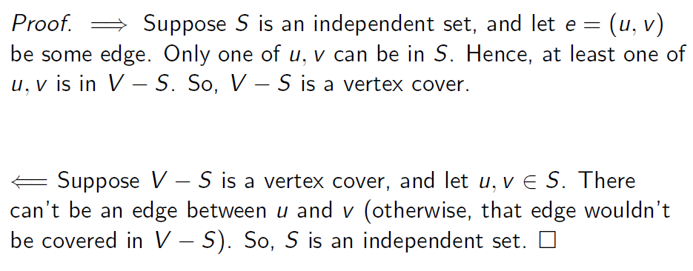
Independent Set to Vertex Cover
Theorem
If G = (V,E) is a graph, then S is an independent set if and only if
V-S is a vertex cover.

